Slide 1
m2m air
Cloud
Telit
Mobile App
By Kimaia

Slide 2
User Experience (UX) design
  Web vs. Mobile
    Replication vs. Extension
    Functional vs. Sexy
    Absolute vs. User Related
  Mobile focus
    Monitor – any time, any where
    Response - immediate
    Admin ?

Slide 3
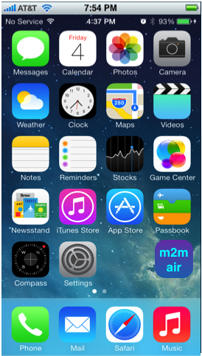
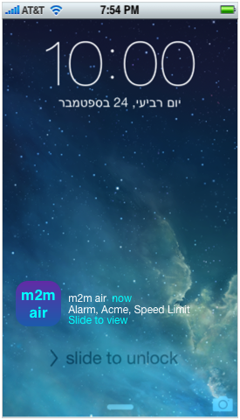
Usage flows & Entry points
  Monitor –
  user initiated
  Response –
  system notification initiated

Slide 4
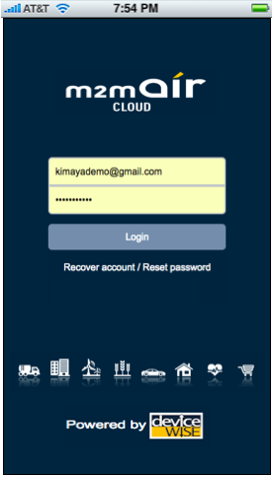
Login view
  Entry point on app’s first use.
  Web vs. Mobile
    Single user vs. multiple users

Slide 5
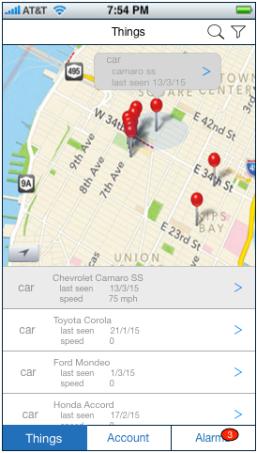
Things view
  Map view.
    Standard map controls
      Zoom, Scroll and Pan
      Map layers
      My location
      Tap for full map view (table hides)
  Table view
    Sorted by user location vicinity
    Scroll for more
  Things manipulation
    Tap a pin for a preview
      Thing’s table cell marked also
    Tap a preview arrow to drill down
    Filter and Search

Slide 6
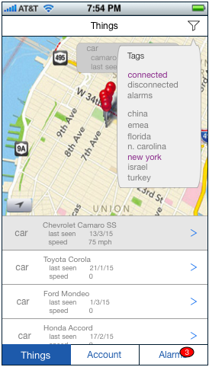
Things view - Filter tool
  Tap icon to open
  Use ‘Tag cloud’ to filter map and table
    and / or query?
  Filter remains throughout usage
  Filtering applies also in Alarms views

Slide 7
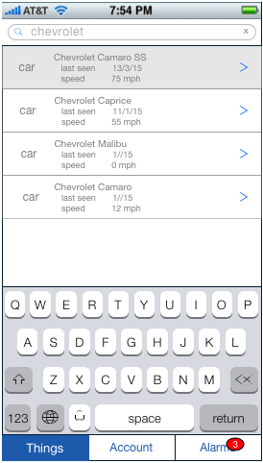
Things view - Search tool
  Tap icon to activate
  Perform search over Things’ definitions
  Results show in Table view
  Search applies also in Alarms views

Slide 8
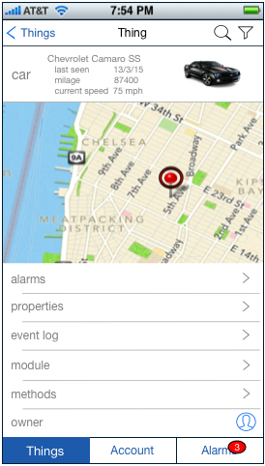
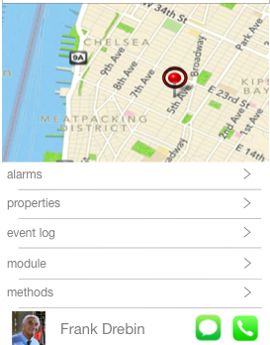

Thing view
  Thing’s definition summery
  Map location + History
  Thing’s data and action items
    Alarms
    Properties
    Event log
    Module – AT command shell (?)
    Methods (?)
    Owner – Asset’s owner (driver) contact
      Call or SMS at emergency

Slide 9
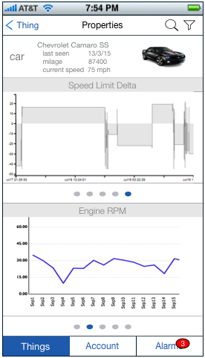
Thing’s Properties view
  Properties’ aggregated data in graphical form
    One or two properties displayed simultanously
    Slide properties with Page control
    Pan or Zoom graph to travel and focus
    Tilt to shift Portrait / Landscape orientation

Slide 10
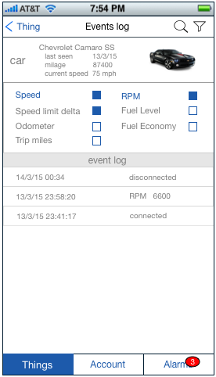
Thing’s Event log view
  Thing’s Events log in table form
  Check specific properties to filter the log

Slide 11
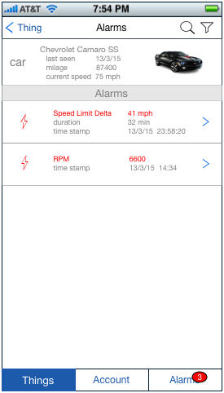
Thing’s Alarms view
  Thing’s Alarms in table form
  Alarm’s preview data - Tap to drill down.

Slide 12
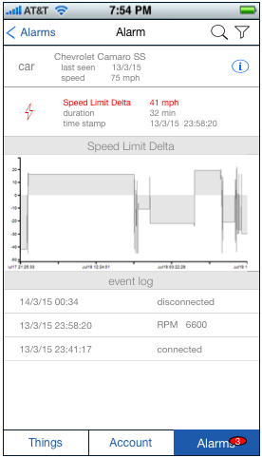
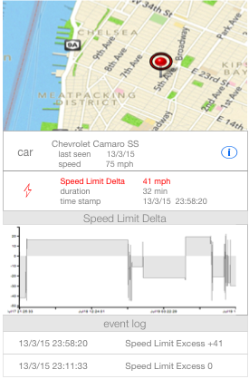
Alarm view
  Map view
  Thing’s context
  Alarm info
  Triggering property displays
    Graph presentation
    Filtered event log

Slide 13
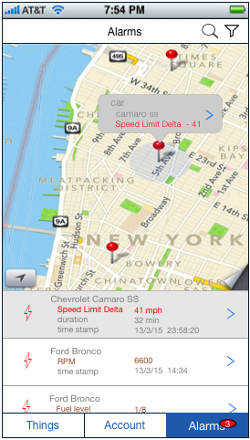
Alarms view
  Use case Alarms monitor – Tab to initiate
  Map view.
    Standard map controls
      Zoom, Scroll and Pan
      Map layers
      My location
      Tap for full map view (table hides)
  Table view
    Alarms’ preview info
    Scroll table for more
    Filter and Search
  Alarms manipulation
    Tap a pin for an Alarm’s preview
      Alarm’s table cell marked also
    Tap a preview to drill down

Slide 14
Alarm view
  Map view
  Thing’s context
  Alarm info
  Triggering property displays
    Graph presentation
    Filtered event log

Slide 15
Use case - Response
  M2M server pushes an alarm notification

Slide 16
Usage flow - Response
  On entry, user is positioned in most relevant context

Slide 17
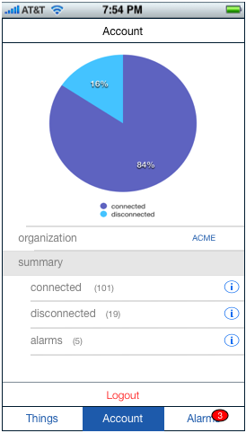
Account view
  Organization picker
  Account summary
  Logout (single exit point)

